Slide 1

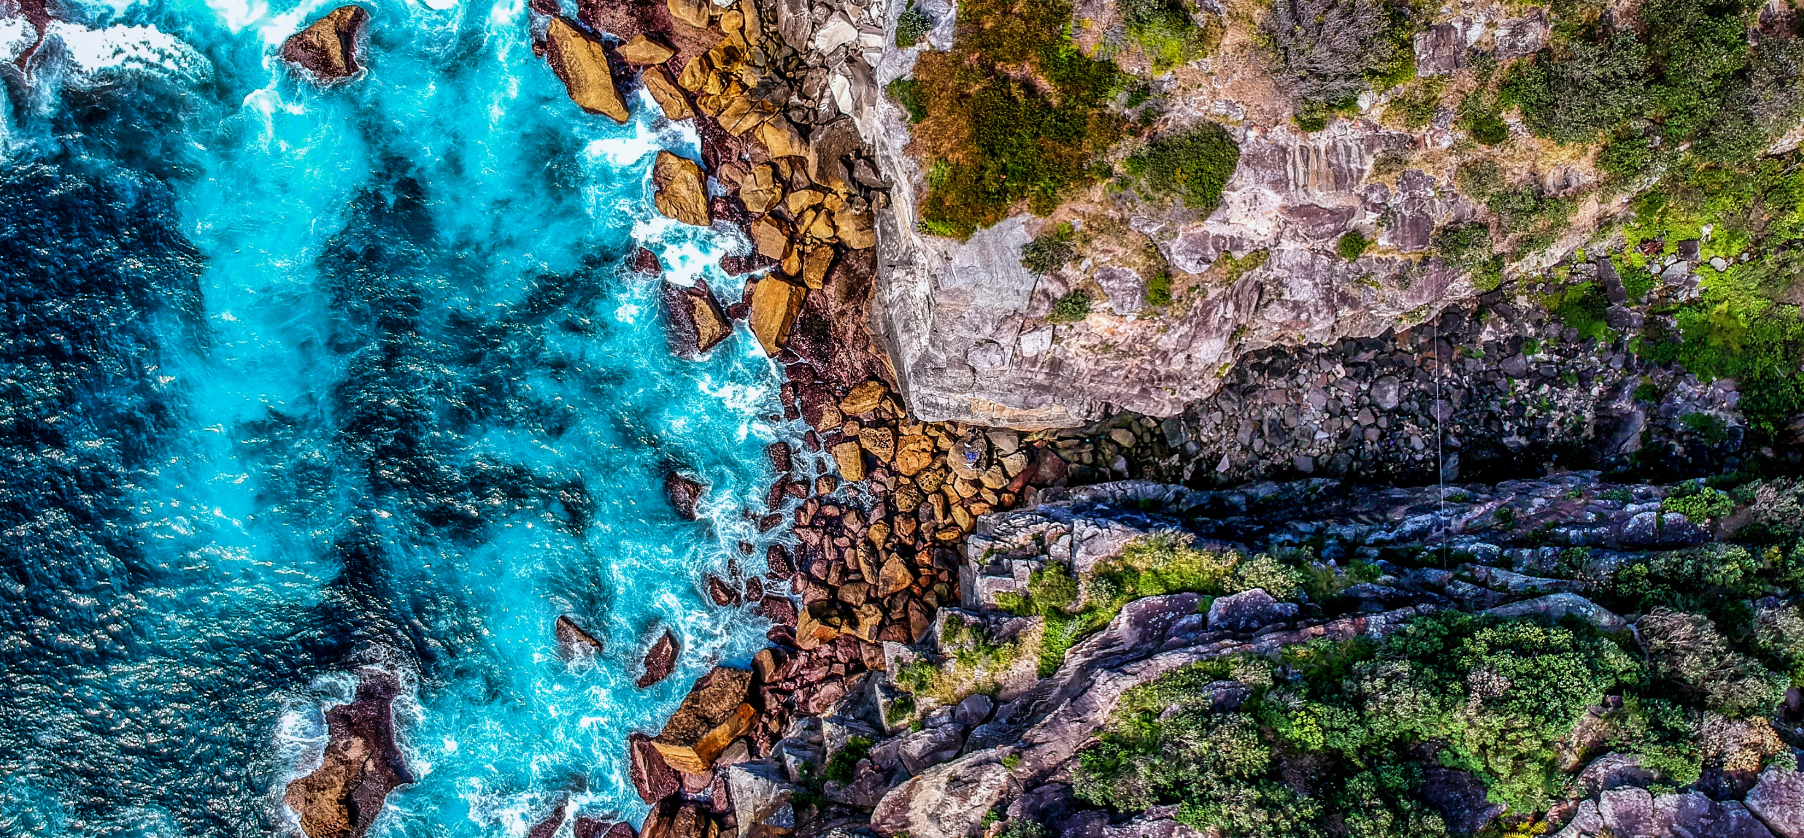

GCSE (9-1)
GEOGRAPHY A
Guidance and support for 2021
J383
For first teaching in 2016

Slide 2
Ofqual consultation decisions – August 2020
The following information applies to current Year 11 students for the academic year 2020-2021.
Students will not be assessed on their own fieldwork experience in the exam.
Centres do not need to sign a Fieldwork Statement confirming that fieldwork has taken place on at least two occasions (as per the specification).
Fieldwork can be undertaken ‘in the field’ or through virtual fieldwork.
© OCR 2020
Notes:
https://assets.publishing.service.gov.uk/government/uploads/system/uploads/attachment_data/file/906173/Consultation_decisions_-_proposed_changes_to_the_assessment_of_GCSEs__AS_and_A_levels_in_2021.pdf

Slide 3
Assessment of fieldwork for 2021
Students will not be asked questions during the exams related to their own fieldwork
HOWEVER
Students will be asked questions during the exams on unfamiliar fieldwork contexts
The unfamiliar fieldwork questions will:
total 15 marks in the exam.
still be included in section B of components 03.
be in the same style as those shown in the Sample Assessment Material, Practice Paper, and the past papers from 2018 and 2019.
© OCR 2020

Slide 4
What has not changed for 2021?
There has been no change to the specification content. Therefore, themes 1.1 – 2.3 (specification p6-12) and the geographical skills (p13-14) will need to be taught.
Components 01 and 02 will follow the same structure as previous years.
© OCR 2020

Slide 5
Assessment overview – Components 03
The following information applies to Components 03 ONLY.
Green highlighting indicates a change for 2021.
 | Previous years | 2021
Exam duration | 1 hour 30 minutes | 1 hour 20 minutes
Exam paper total | 80 marks | 65 marks
Exam paper weighting | 40% | 35.2%
Fieldwork question totals | 30 marks | 15 marks
Question types | Own fieldwork Unfamiliar fieldwork contexts | Unfamiliar fieldwork contexts
© OCR 2020
Notes:
What has changed for 2021:
15 marks have been removed for the assessment of own fieldwork
Component 03 is 10 minutes shorter (due to the removal of the own fieldwork questions)
The exam paper total for component 03 has decreased by 15 marks (due to the removal of the own fieldwork questions)
The weighting of the exam paper has decreased (the weighting of components 01 and 02 have both increased from 30% to 32.4%)

Slide 6
Component 03 – in more depth
The unfamiliar fieldwork questions will be included within section B of component 03.
In section B, there will be 7 marks for lower tariff questions and one higher tariff question (8 marks) with a further 3 marks for SPAG.
The exam questions will include both physical and human geography fieldwork contexts.
  Human geography fieldwork context – Urban
  Physical geography fieldwork context – Coasts
© OCR 2020
Notes:
In 2021,
We will not be asking questions based on students’ own fieldwork experience (15 marks). There is now a reduction of 10 x AO3 marks and 5 x AO4 marks
There are 15 marks for the assessment of unfamiliar fieldwork questions, in section B of component 03. The assessment objectives for these are:​
10 marks (5.7%) to the assessment of AO3 in relation to fieldwork contexts
5 marks (2.8%) to the assessment of AO4 in relation to fieldwork contexts

Slide 7
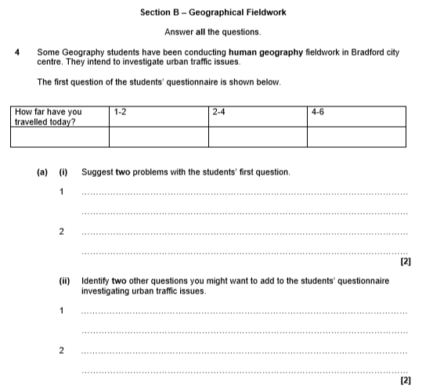
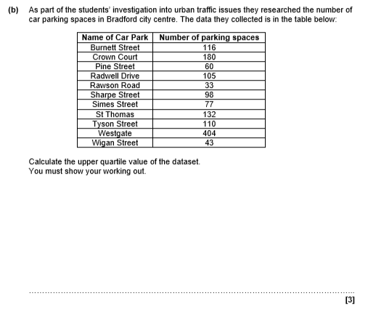
Sample Assessment Materials
Question 4
Component 03 – Section B
These questions will target AO4 and AO3.
Human geography fieldwork – 7 marks (low tariff questions)
© OCR 2020
Notes:
Assessment Objectives
AO3 – Students are required to apply their knowledge and understanding.
AO4 – geographical skills
The SAMs questions target -
4(a)(i) AO3, (a)(ii) AO4 and (b) AO4
Question 4(a)(i) students need to apply their knowledge and understanding to fieldwork skill (ii) (p15) and it is assessing geographical skill (3.3.6 p14)
Question 4(a)(ii) students are being assessed on fieldwork skill (i) and geographical skill 3.3.6
Question 4(b) Students are being assessed on fieldwork skill (iii) and geographical skill 3.3.4. This question has development marks for parts of the calculation

Slide 8
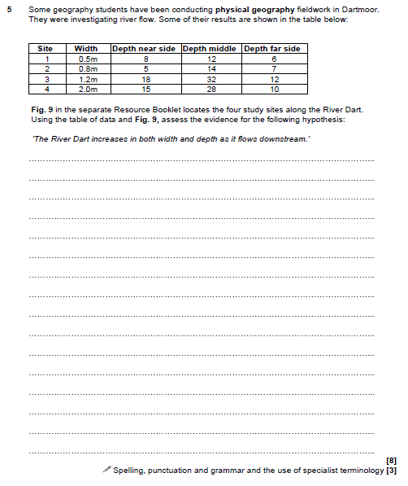
Sample Assessment Materials
Component 03 – Section B
Question 5
Physical geography fieldwork: one higher tariff question of 8 marks with a further 3 marks for SPAG.
Qu 5 – AO3
This is an extended response, level marked question.
Students need to analyse the hypothesis and refer to the table of data and fig. 9 in their answer.
© OCR 2020
Notes:
Assessment Objectives
AO3 – Students are required to apply their knowledge and understanding.

Slide 9
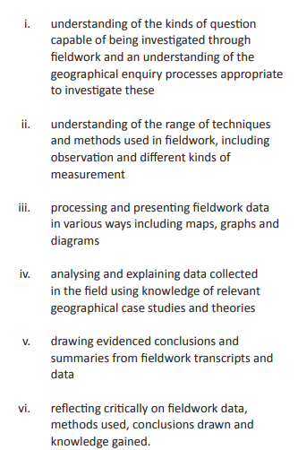
Assessing fieldwork skills
These fieldwork skills can be found on p15 of the specification.
At least 2 of these will be assessed in the 15-mark unfamiliar fieldwork questions.
These skills are explained in lots more detail in the GCSE Fieldwork skills factsheet.
© OCR 2020

Slide 10
GCSE A assessment overview
Current
2021
Green highlighting indicates a change for 2021.
J383 | Component 01 | Component 02 | Component 03
Exam duration | 60 minutes | 60 minutes | 1 hour 30 minutes
Total number of marks | 60 | 60 | 80
Weighting of papers | 30% | 30% | 40%
Qualification total
200 marks
J383 | Component 01 | Component 02 | Component 03
Exam duration | 60 minutes | 60 minutes | 1 hour 20 minutes
Total number of marks | 60 | 60 | 65
Weighting of papers | 32.4% | 32.4% | 35.2%
Qualification total
185 marks
© OCR 2020

Slide 11
Further examples of questions
Did you know you could use ExamBuilder to design your own question papers?
You could show your students further examples of how component 03 will look in 2021.
Build your own question paper with our tool.
© OCR 2020

Slide 12
Preparing students
To prepare students for the unfamiliar fieldwork questions, teachers should provide students with the opportunity to:
engage in the enquiry process (see slide 9)
and
engage in fieldwork where possible, whether that is;
  ‘in the field’ e.g. school grounds and local area (to the school or student’s home)
  through virtual fieldwork (classroom based)
© OCR 2020

Slide 13
Fieldwork ideas
School grounds
Modelling geomorphic processes on the playing field
Conducting a questionnaire e.g. ways of life (leisure and consumption)
Measuring footfall, data processing and analysis
Measuring and monitoring sustainability e.g. recycling (data collection) and
student/staff survey (qualitative information)
Microclimate study
Local area (to the school or student’s home)
Traffic management (Traffic and pedestrian survey)
Neighbourhood survey (Ways of life – housing, leisure and consumption)
Infiltration rates (man-made surfaces versus natural)
Ecosystems – plant and insect quadrat survey
© OCR 2020

Slide 14
Virtual fieldwork
What do we mean by virtual fieldwork?
‘Opportunity to develop a sense of place remotely using maps, images, data and information without directly visiting that particular place. Geographical enquiry and fieldwork skills can be integrated into the delivery of virtual fieldwork’.
The enquiry process can be followed, which could include the collection of data, images and the development of a sense of place. For example, this can take place through the use of media, photographs, interviews and recordings and through online platforms such as google maps, street view and OS maps.
© OCR 2020

Slide 15
Virtual fieldwork – Example
Are there opportunities to combine topic teaching and virtual fieldwork delivery?
1.3 UK Environmental Challenges – 1.1b Case study of one UK flood
Enquiry question: ‘How badly affected were the people of X by the flood?’
Student research: What sources of information can we find to show the impact of flooding on X?
Map and images to show the impact of flooding on people's homes, businesses and transport links. Students categorise severity of the impact.
Newspaper articles – extract positive and negative impacts.
Flood impact data e.g. death toll, cost of damage, loss of business/ tourist revenue, transport links.
What does all the evidence tell students about ‘how badly affected people were’? This statement requires a ‘value judgement’ – how will students produce an answer?
The Geographical Association has some great resources to investigate the impact of flooding.
© OCR 2020
Notes:
Field Studies Council https://www.geography-fieldwork.org/a-level/water-carbon/flooding/
https://nationalfloodforum.org.uk/working-together/communities/impact-on-communities/

Slide 16
Virtual fieldwork – Example
Are there opportunities to combine topic teaching and virtual fieldwork delivery?
1.2 People of the UK – Case study of one major city
Enquiry question: ‘What evidence is there that X has been influenced by migration’?
This question is asking students to investigate migration, how many people have arrived in X, over what time period? You / the students may want to define a time period. Linking to the specification, students could find the influence of migration from the changing character of X.
Collection of street images over time - Ask students to ‘spot the difference’ and compile a list. What does it show has changed?
Migration data – graph and map it. How many migrants and where do they live?
Living map activity – Google maps, street view and census / local authority data (wards) – what can students find out about those areas where migrants are living? E.g. languages, ethnic origin, shops, leisure facilities, places worship etc. Annotate their map with text and images.
Media / social media migrant stories, what’s the link to place X (positive / negative language?)
© OCR 2020
Notes:
Here is an example of Investigating urban change virtually

Slide 17
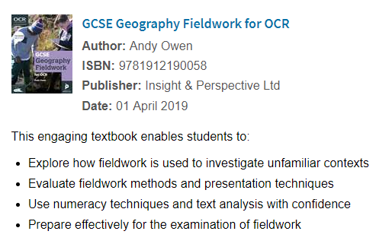
Supporting teachers
Current OCR materials available to support you:
GCSE Fieldwork skills factsheet
Embedding fieldwork skills activities
Investigating urban change virtually
Embedding geographical skills activities
All materials can be found within planning and teaching.
Geographical skills
Supporting the delivery of geographical skills for OCR Geography A and B.
Geographical skills graphs and charts
Geographical skills – maps to be studied
Endorsed fieldwork textbook
Fieldwork book for GCSE A and B.
© OCR 2020

Slide 18
Field Studies Council (FSC)
https://www.geography-fieldwork.org/gcse/
#fieldworklive
Teacher Guidance, Pre-lesson preparation, Student sheet, Fieldwork video
How does quality of life vary in an urban centre?
Impact of coastal management
Using GIS in geographical enquiry
© OCR 2020

Slide 19
Subject Associations
Geographical Association
https://www.geography.org.uk/Geographical-Investigations-Virtual-fieldwork
Geography Education Online (GEO)
https://www.geography.org.uk/Geographical-enquiry-in-the-classroom
Royal Geographical Society (with IBG)
https://www.rgs.org/in-the-field/fieldwork-in-schools/fieldwork-resources/
© OCR 2020
Notes:
Geographical Association (for members, magazine subscription)
‘It’s virtually a glacier’, Alice Matthews, Spring 2020 (https://www.geography.org.uk/Journal-Issue/dacfba66-4914-4e2a-b103-5f7b34f3a912)
‘Virtual field tripping’, Lucy Fryer, Autumn 2017 https://www.geography.org.uk/Journal-Issue/2124e048-3d6f-4ad1-a243-2869424ae29b
‘Digimap for schools: what is it and what can you do with it?’ Darren Bailey, Summer 2018 (https://www.geography.org.uk/Journal-Issue/a1750706-4982-4162-a32f-58c4e6b12f17)
‘GIS has changed! Exploring the potential of Arc-GIS Online’, Harry West and Michael Horswell, Spring 2018 (https://www.geography.org.uk/Journal-Issue/00dff576-66ef-491b-8a58-2db4618d0b9f)
‘Capturing a sense of place through fieldwork’, Sophie Brand, Spring 2020 (https://www.geography.org.uk/Journal-Issue/0b02fa2b-f972-4c90-aa6e-fff707996c01)
‘Casting aside our hammers: creative fieldwork approaches and methods’, Janine Maddison, Robyn Landy, Autumn 2018 (https://www.geography.org.uk/Journal-Issue/fcf8f117-87b2-4f47-af7e-121dfd1f6207)

Slide 20

Do get in touch . . .
Geography Subject Advisor – Shelley Monk
Email geography@ocr.org.uk
Twitter @OCR_Geography
Telephone 01223 553998
© OCR 2020

Slide 21
We’d like to know your view on the resources we produce. Click ‘Like’ or ‘Dislike’ to send us an auto generated email about this resource. Add comments if you want to. Let us know how we can improve this resource or what else you need. Your email will not be used or shared for any marketing purposes.
Looking for another resource? There is now a quick and easy search tool to help find free resources for your qualification.
Resources: the small print
OCR provides resources to help you deliver our qualifications. These resources do not represent any particular teaching method we expect you to use. We update our resources regularly and aim to make sure content is accurate but please check the OCR website so that you have the most up to date version. OCR cannot be held responsible for any errors or omissions in these resources.
Though we make every effort to check our resources, there may be contradictions between published support and the specification, so it is important that you always use information in the latest specification. We indicate any specification changes within the document itself, change the version number and provide a summary of the changes. If you do notice a discrepancy between the specification and a resource, please contact us.
You can copy and distribute this resource freely if you keep the OCR logo and this small print intact and you acknowledge OCR as the originator of the resource.
© OCR 2020 OCR acknowledges the use of the following content: Front image – Slizard Toth/Shutterstock.com, Slide 20 – Questions Oliver Le Moal/Getty Images
Whether you already offer OCR qualifications, are new to OCR or are thinking about switching, you can request more information using our Expression of Interest form.
Please get in touch if you want to discuss the accessibility of resources we offer to support you in delivering our qualifications.

