Slide 1

Applied Anatomy and Physiology

Slide 2
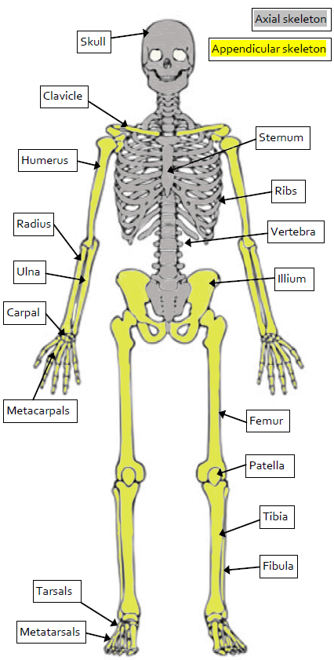
Learning Outcomes
1.1.a. The Structure and Function of the Skeletal System
Cranium
Pelvis
By the end of this topic you should …
  Know the name and location of bones in the human body.
  Be able to describe the 6 functions of the skeleton.
  Know the definition of a synovial joint.
  Know hinge joints and ball and socket joints
  Know the types of movements at hinge and ball and socket joints.
  Know the roles of ligaments, cartilage and tendons.
Phalanges
Phalanges

Slide 3
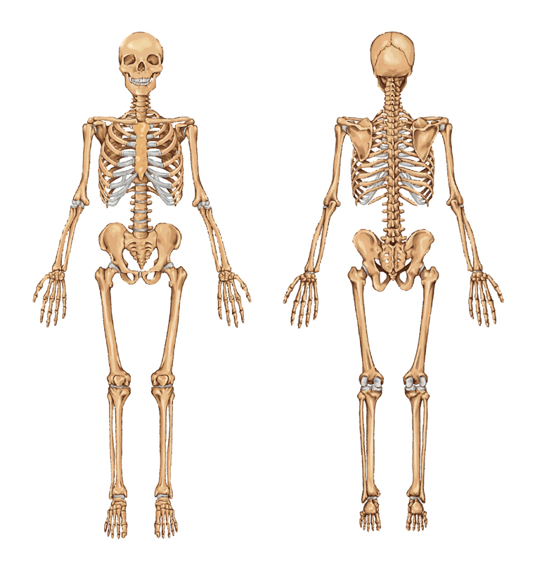
Know the location of the major bones
The adult skeleton has 206 bones and provides the framework for all movement.
PRACTICAL TASK:
Using the Labels and marker pen on your table, can you identify the location of the major bones on your ‘designated dummy!’
You need to know the location of the following bones:
Cranium
Vertebrae
Ribs
Sternum
Clavicle
Scapula
Humerus
Ulna
Radius
Carpals
Metacarpals
Phalanges
Pelvis
Femur
Patella
Tibia
Fibula
Tarsals
Metatarsals

Slide 4
Know the location of the major bones
So How did we do?!
Who will be the winning table!
For each bone you correctly label you will earn yourself a point!
Most points WIN!

Slide 5
Know the location of the major bones
Head/Neck joint
Cranium
Vertebral column

Slide 6
Know the location of the major bones
Shoulder joint
Scapula
Humerus
Clavicle

Slide 7
Know the location of the major bones
Chest region
Ribs
Sternum

Slide 8
Know the location of the major bones
Elbow region
Humerus
Radius
Ulna

Slide 9
Know the location of the major bones
Hip joint
Femur
Pelvis

Slide 10
Know the location of the major bones
Femur
Patella
Knee joint
Tibia

Slide 11
Know the location of the major bones
Fibula
Tibia
Talus
Ankle joint

Slide 12
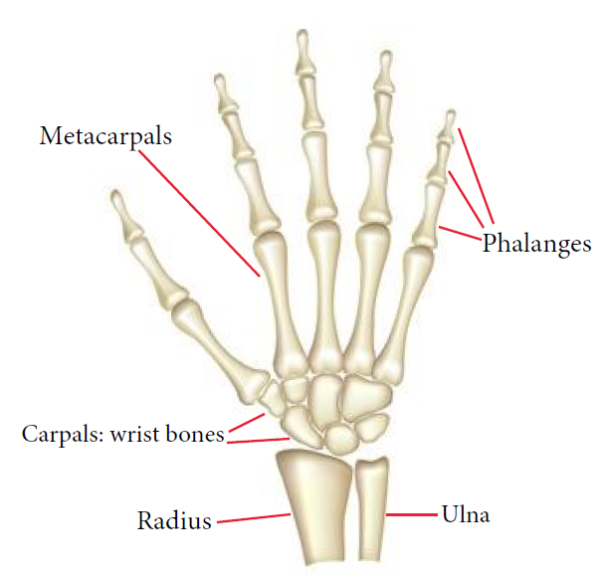
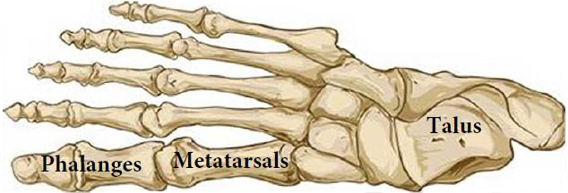
Know the location of the major bones
Bones of the HAND
Bones of the FOOT

Slide 13
Know the location of the major bones
And Our Winners Are!

Slide 14
Main functions of the skeleton
How might we remember these?
https://www.youtube.com/watch?v=aUHh8uMdBso
Did you get these?
1. To give Posture and Support to the body
2. To allow Movement of the body
3. To give Protection to the internal organs
4. To produce Blood (White and Red) Cells
5. To Store Minerals

Slide 15
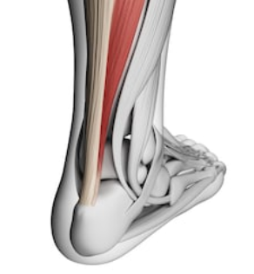
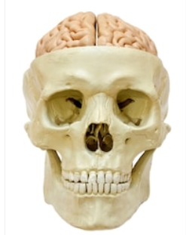
Main functions of the skeleton
1. Support
It gives the body support, enabling us to stand. The bones of the body are held together by ligaments.
The skeleton provides a framework for the muscles, which are attached to bones by tendons.
2. Protection
Some of our body parts, such as the brain, are very delicate and need protection.
Bones can protect body parts from impacts and injuries.
What vital organ does the Cranium protect?
What vital organ does the Rib Cage protect?

Slide 16
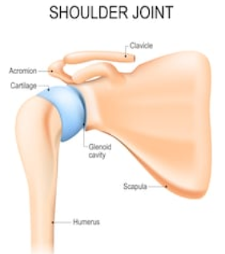
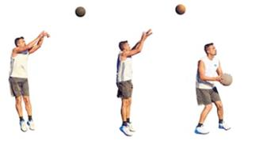
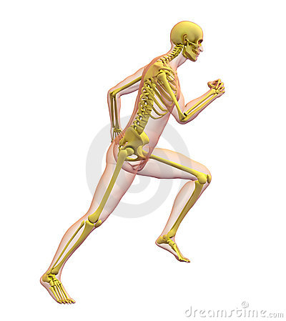
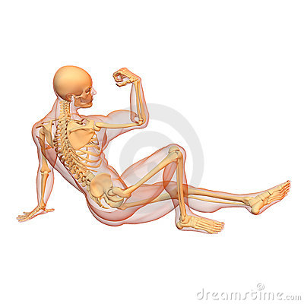
Main functions of the skeleton
3. Movement
The skeleton has many different joints.
At joints, muscles and bones form levers to
allow sporting movements.
4. Posture & Structural Shape
The skeleton acts as a framework.
Muscles are firmly attached to bones forming our body shape and holds us upright.

Slide 17
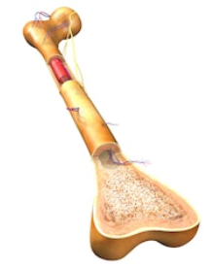
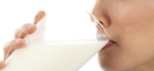
Main functions of the skeleton
5. Mineral Storage
The minerals in your bones serve two main functions.
Minerals transform spongy bone matrix into a rigid structure and in turn increase density and strength.
Your bones also function as a mineral storage depot, releasing dissolved calcium, phosphorus and magnesium into your bloodstream when needed.

Slide 18

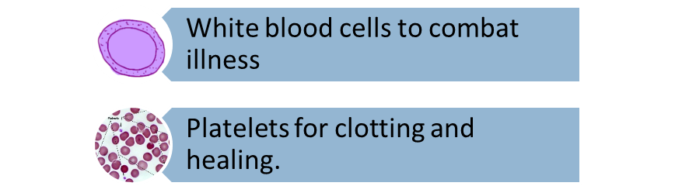
Main functions of the skeleton
6. Blood cell production
The ends of long bones and some other bones including the ribs, humerus, femur and even vertebrae bones, contain red bone marrow.
This is where the red blood cells are produced
which carry oxygen.
Other functions include:

Slide 19
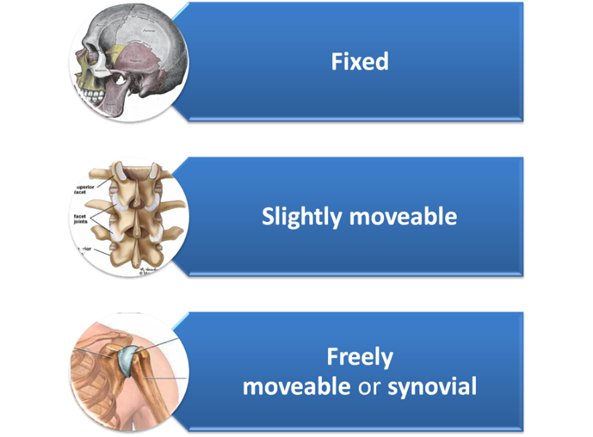
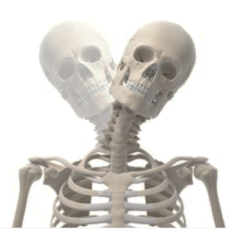
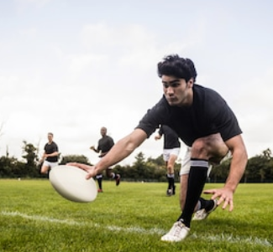
Types of synovial joint
Structure of the skeleton
“A joint is a place where two or more bones meet”
The skeletal system has a number of joints which are responsible for the huge range of movement.
There are several different types of joint in the body which allow different types of movement.
These different Type of Joint include:

Slide 20
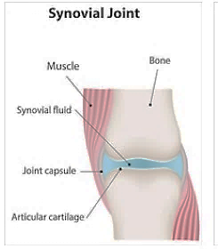
Types of synovial joint
Synovial Joints https://www.youtube.com/watch?v=0cYal_hitz4
A Synovial Joint is a freely movable joint in which the bones surfaces are covered by cartilage, called Articular Cartilage, and connected by a fibrous connective tissue capsule lined with Synovial Fluid
You Need to Know This!

Slide 21
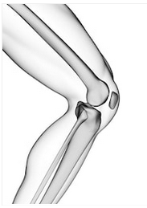
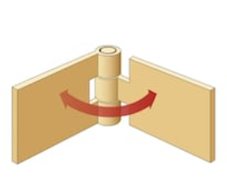
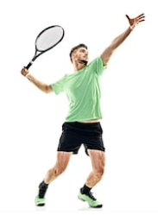
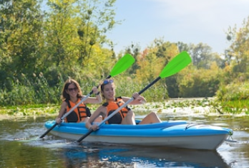
Types of synovial joint (hinge joint)
Hinge Joints
Only allow flexion and extension movement like the hinge on a door.
Examples found in the body are the knee and elbow joints
Why are these joints important for sport?
These joint are extremely powerful and in conjunction with surrounding muscles can produce power and speed i.e. Knee drive during a 100m sprint
The Articulating bones are bones that move within a joint, for example the Articulating bones for the elbow joint are:
Humerus
Radius
Ulna

Slide 22
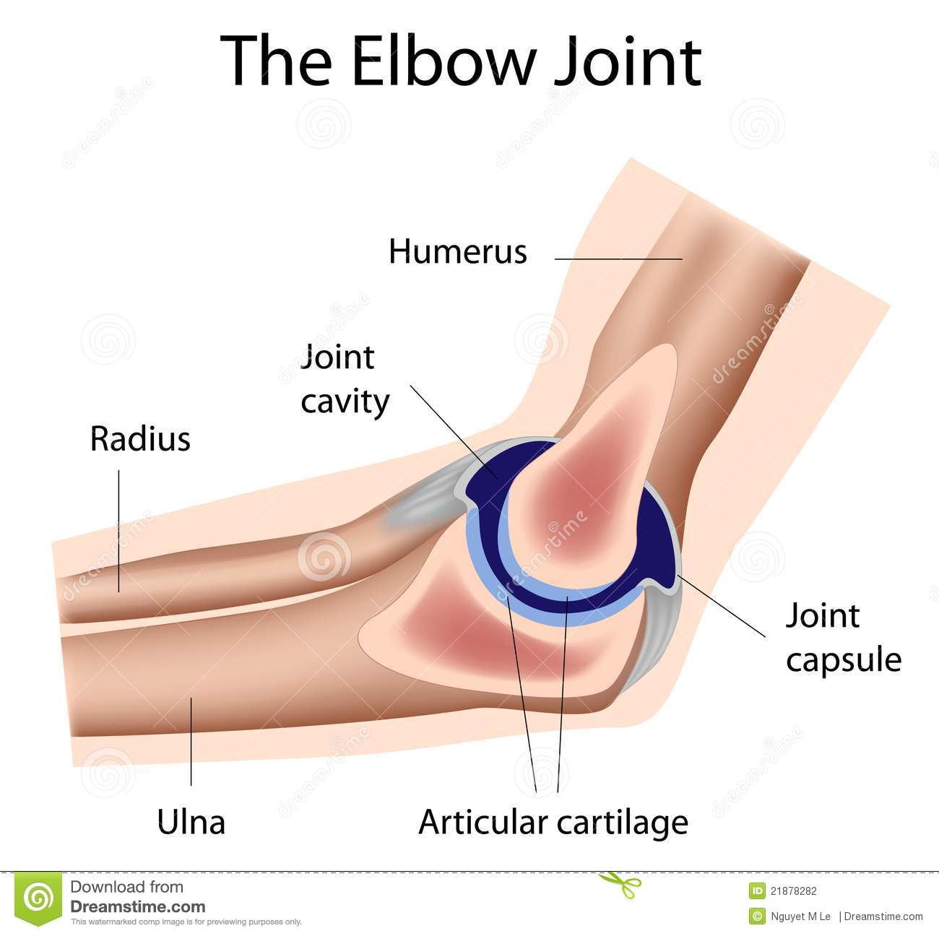
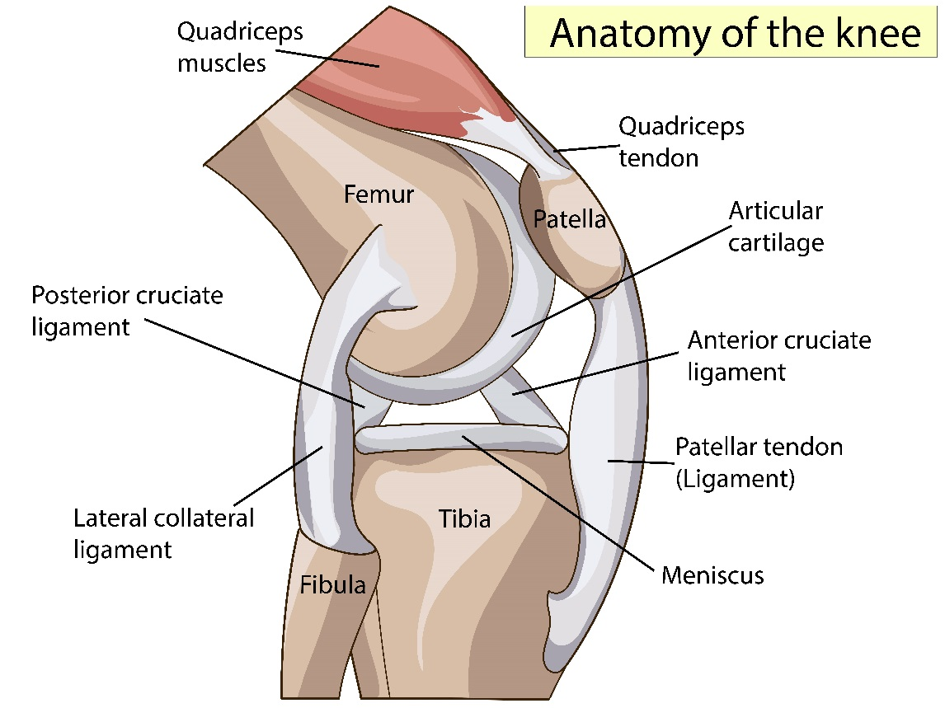
Types of synovial joint (hinge joint)
Hinge Joints
You need to know the make up of the Knee and Elbow Joints.

Slide 23
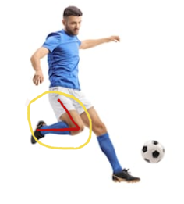
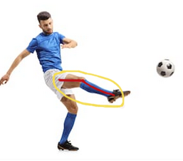
Types of movement at hinge joints
Movement at A Hinge Joint
FLEXION – Decreasing the angle at a joint. (Bending the leg at the knee joint)
EXTENSION - Increasing the angle at a joint. (Straightening the leg at the knee joint)
Flexion
Extension
TASK: Describe a specific sporting example of both Flexion and Extension at both
the Knee and the Elbow.

Slide 24
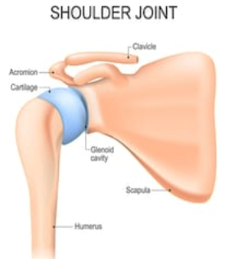
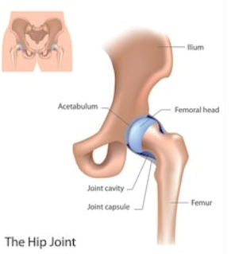
Types of synovial joint (ball and socket)
Ball & Socket Joints
You need to know the make up of the Shoulder and Hip Joints.
Humeral Head
Femoral Head
(ball)
Acetabulum
Glenoid cavity
(socket)

Slide 25
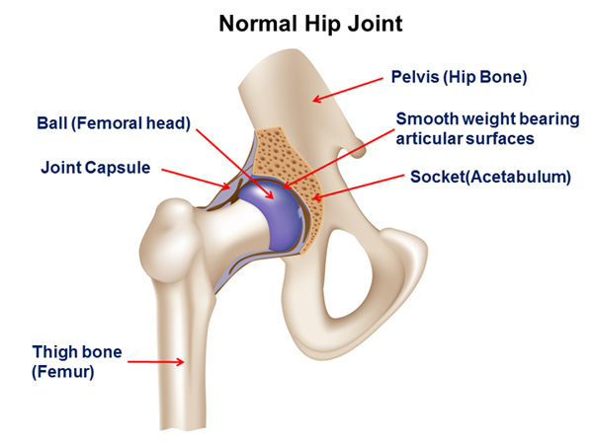
Types of synovial joint (ball and socket)
Ball & Socket Joints
You need to know the make up of the Shoulder and Hip Joints.

Slide 26
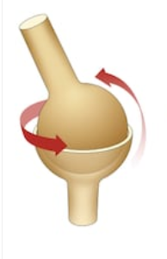
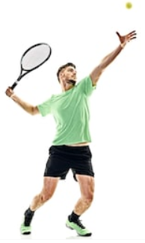
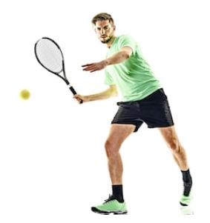
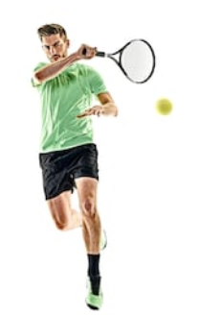
Types of movement at ball and socket joints
Ball & Socket Joints
Where the rounded end of one bone fits inside the
cup-shaped end of another bone.
Ball and socket joints allow movement in all directions.
These are the most mobile joints in the body.
Examples found in the body include the shoulder and hip joints.
Why are these joints important for sport?
Most sporting movements require the type of movement the shoulder and hip allow. i.e. tennis serve

Slide 27
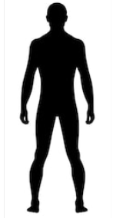
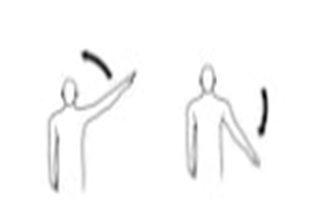

Types of movement at ball and socket joints
Movement at a Ball & Socket joint
Flexion and Extension: Increasing and decreasing the angle at the joint.
Abduction and Adduction: determined from the ‘MIDLINE’ of the body.
Abduction
Adduction

Slide 28
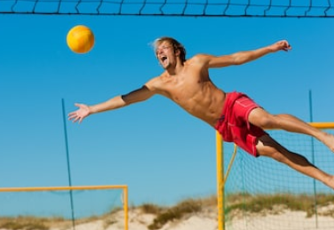
Types of movement at ball and socket joints
Adduction & Abduction
ADDUCTION –
Sideways moving limb towards midline of the body.
ABDUCTION –
Sideways moving limb away from midline of the body
REMEMBER: Adduction is to ADD towards the midline.
REMEMBER: Abduction is to TAKE AWAY from the midline.

Slide 29
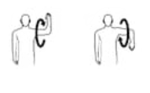
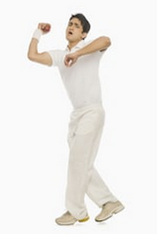
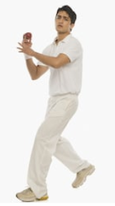
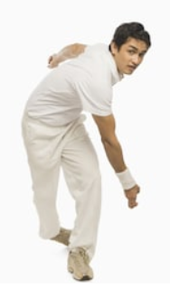
Types of movement at ball and socket joints
Movement at a Ball & Socket joint
Rotation/Circumduction: The joint moves in a circular motion. e.g. Service action or bowling action.
Let’s See if you Fully Understand
TASK 1: Draw and describe a simple diagram of the Knee Joint and label the bones that move around this (the Articulating Bones)
TASK 2: Name a Physical Activity that involves both Flexion and Extension of the Knee Joint
TASK 3: Draw and describe a simple diagram of the Hip Joint and label the bones that move around this (the Articulating Bones)
TASK 4: Describe a skill in a physical activity that involves both abduction and adduction of the hip joint.

Slide 30
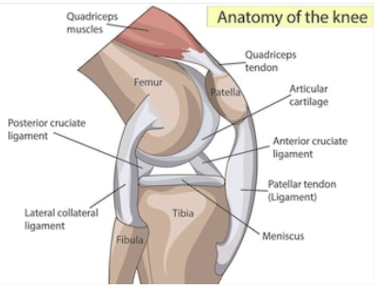
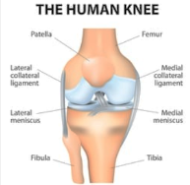
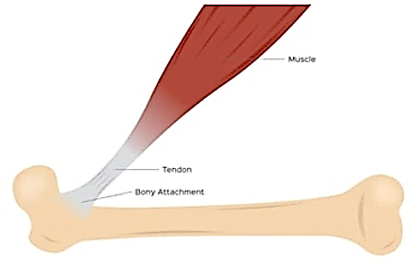
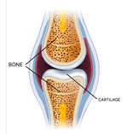
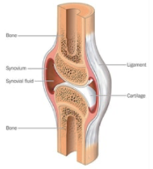
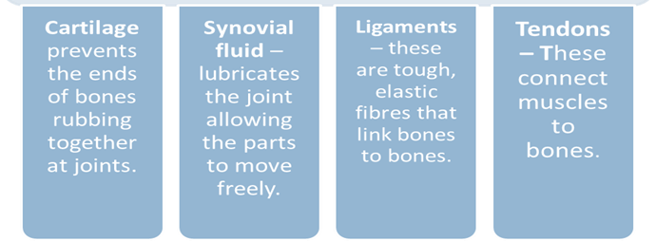
Other components of joints
Structure of a synovial joint

Slide 31
Other components of joints
Structure of a synovial joint
YOU NEED TO KNOW THESE!
Ligaments:
Bands of connective tissue that connect bone to bone & stabilise moment.
Cartilage:
Designed to reduce friction and act as a shock absorber for the joint
Synovial fluid:
Acts like an oil and lubricates the joint.
Tendons:
Attach Muscle to Bone (example - Achilles tendon)
A Synovial Joint
is a freely movable joint in which the bones surfaces are covered by cartilage, called Articular Cartilage, and connected by a
fibrous connective tissue capsule lined with Synovial Fluid

Slide 32
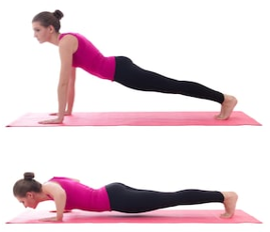
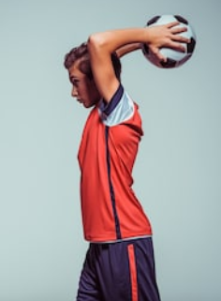
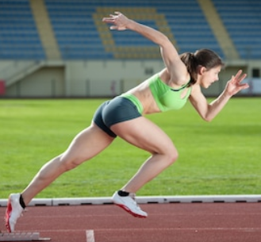
Apply your knowledge
TASK: USE YOUR KNOWLEDGE OF THE SKETAL SYSTEM TO LABEL AS MUCH INFO AS POSSIBLE ON THE ATHLETE BELOW.
(BONES / JOINTS /MOVEMENT ACTIONS).

Slide 33
OCR Resources: the small print
OCR’s resources are provided to support the delivery of OCR qualifications, but in no way constitute an endorsed teaching method that is required by the Board, and the decision to use them lies with the individual teacher. Whilst every effort is made to ensure the accuracy of the content, OCR cannot be held responsible for any errors or omissions within these resources.
Our documents are updated over time. Whilst every effort is made to check all documents, there may be contradictions between published support and the specification, therefore please use the information on the latest specification at all times. Where changes are made to specifications these will be indicated within the document, there will be a new version number indicated, and a summary of the changes. If you do notice a discrepancy between the specification and a resource please contact us at:
resources.feedback@ocr.org.uk.
© OCR 2018 - This resource may be freely copied and distributed, as long as the OCR logo and this message remain intact and OCR is acknowledged as the originator of this work. OCR acknowledges the use of the following content:
Please get in touch if you want to discuss the accessibility of resources we offer to support delivery of our qualifications: resources.feedback@ocr.org.uk
3, 5-11 > Skeleton / stihii / Shutterstock.com 12 > Hand / La Gorda / Shutterstock.com 12 > Foot / corbac40 / Shutterstock.com 15 > Foot / Sebastian Kaulitzki / Shutterstock.com 15 > Skull with brain / kavring / Shutterstock.com 15 > Brain / maglyvi / Shutterstock.com 15 > Heart / Bernardo Ramonfaur / Shutterstock.com 16 > Running skeleton / tose / Shutterstock.com 16 > Sitting skeleton / tose / Shutterstock.com 16, 24, 26 > Shoulder / Designua / Shutterstock.com 16 > Throwing men / Gabriele Maltinti / Shutterstock.com 17, 18 > Bone / ciencepics / Shutterstock.com 17 > Glass Milk / Kenneth Man / Shutterstock.com 19 > Skeleton head / Sebastian Kaulitzki / Shutterstock.com 19 > Rugby player / wavebreakmedia / Shutterstock.com | 20 > Synovial joint / joshya / Shutterstock.com 21 > Knee joint / Sebastian Kaulitzki / Shutterstock.com 21, 26 > Hinge / Aldona Griskeviciene / Shutterstock.com 21, 28 > Rowers / Jaysi / Shutterstock.com 21, 26, 27 > Tennis / Franck Camhi / Shutterstock.com 22 > Elbow joint / Alila Medical Media / Shutterstock.com 22 > Knee / Viktoriia Panchenko / Shutterstock.com 23 > Flexion / Ljupco Smokovski / Shutterstock.com 23 > Extension / Ljupco Smokovski / Shutterstock.com 24 > Hip / Alila Medical Media / Shutterstock.com 25 > Hip / Oleksii Natykach / Shutterstock.com 27 > Outline / Anna Rassadnikova / Shutterstock.com 27, 29 > Abduction / Auttapon Wongtakeaw / Shutterstock.com 28 > Beach ball / Kzenon / Shutterstock.com | 29 > Bowler 1 / imagedb.com / Shutterstock.com 29, 31 > Bowler 2 / imagedb.com / Shutterstock.com 29 > Bowler 3 / imagedb.com / Shutterstock.com 30 > Anatomy of the knee / Viktoriia Panchenko / Shutterstock.com 30 > Cartilage / Tefi / Shutterstock.com 30 > Synovial fluid / Blamb / Shutterstock.com 30 > Human Knee / Designua / Shutterstock.com 30 > Tendon / gritsalak karalak / Shutterstock.com 31 > Pushups / Di Studio / Shutterstock.com 31 > Runner / MinDof / Shutterstock.com 31 > Football / Valua Vitaly / Shutterstock.com

